Slide 1


ME 570 Course Presentation
Accelerating genetic algorithms with GPU computing: A selective overview
- John Runwei Cheng and Mitsuo Gen
Presented By – Ankush Kumar Mishra

Slide 2
10000 ft view of the Presentation
Review Paper
Genetic Algorithm
Parallel GA models
Principles for optimizing GPU implementation
Application of GPU architecture for various parallel GA models – Review of various papers
Notes:
Page fades in, red pops up. Only this page

Slide 3
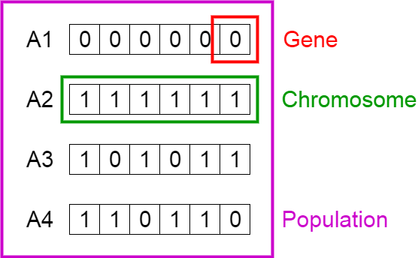
What is Genetic Algorithm?
Search Heuristic – Fittest Individual Selected for Reproduction
Five Key Component
Initial Population
Fitness Function
Selection
Crossover
Mutation
https://towardsdatascience.com/introduction-to-genetic-algorithms-including-example-code-e396e98d8bf3
Notes:
Page fades in, red pops up. Only this page

Slide 4
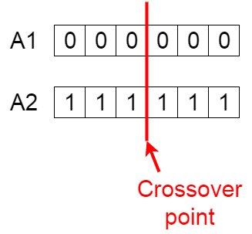
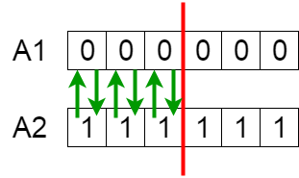
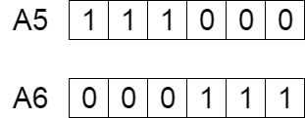
What is Genetic Algorithm?
Search Heuristic – Fittest Individual Selected for Reproduction
Five Key Component
Initial Population
Fitness Function
Selection
Crossover
Mutation
https://towardsdatascience.com/introduction-to-genetic-algorithms-including-example-code-e396e98d8bf3
Notes:
Page fades in, red pops up. Only this page

Slide 5
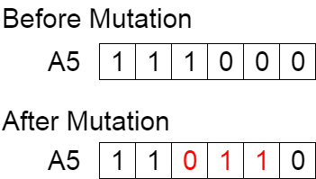
What is Genetic Algorithm?
Search Heuristic – Fittest Individual Selected for Reproduction
Five Key Component
Initial Population
Fitness Function
Selection
Crossover
Mutation
https://towardsdatascience.com/introduction-to-genetic-algorithms-including-example-code-e396e98d8bf3
Notes:
Page fades in, red pops up. Only this page

Slide 6
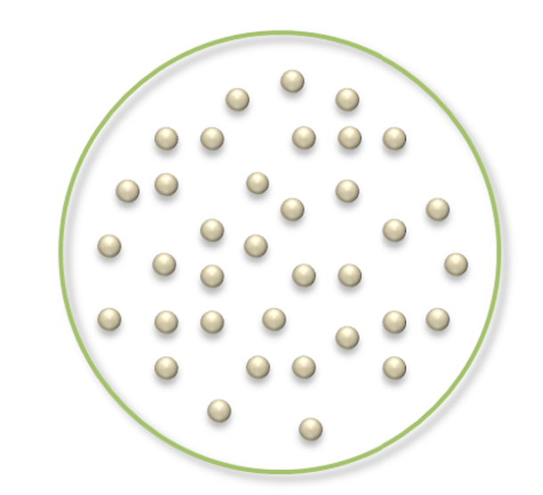
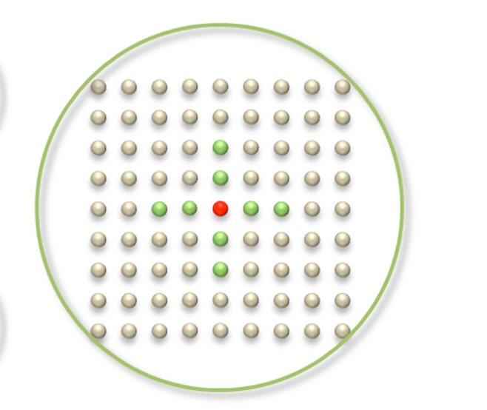
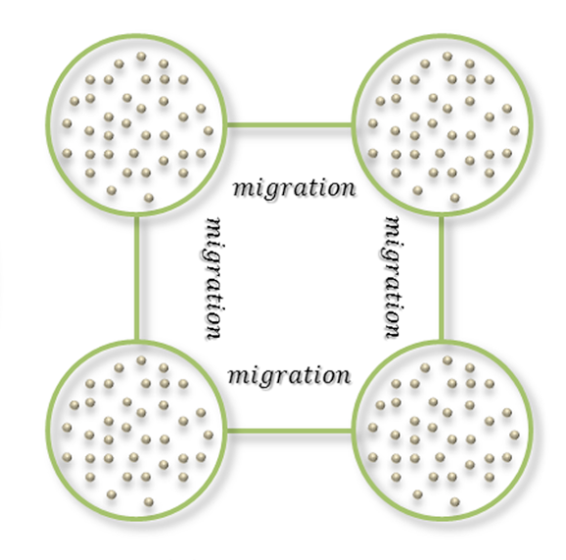
Scope of Parallelization: Parallel GA Models
Master-Slave Model | Cellular Model | Island Model
Global Mating | Local Mating | Hybrid Mating
Migration Operator exchanges sub-population periodically
Notes:
Page fades in, red pops up. Only this page

Slide 7
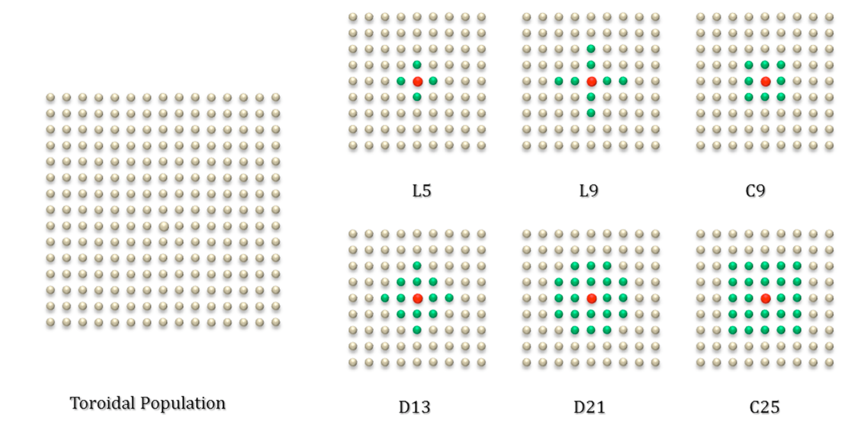
Cellular Models: Neighborhood Topolgy
L - Linear , C - Compact, D - Diamond
Notes:
Page fades in, red pops up. Only this page

Slide 8
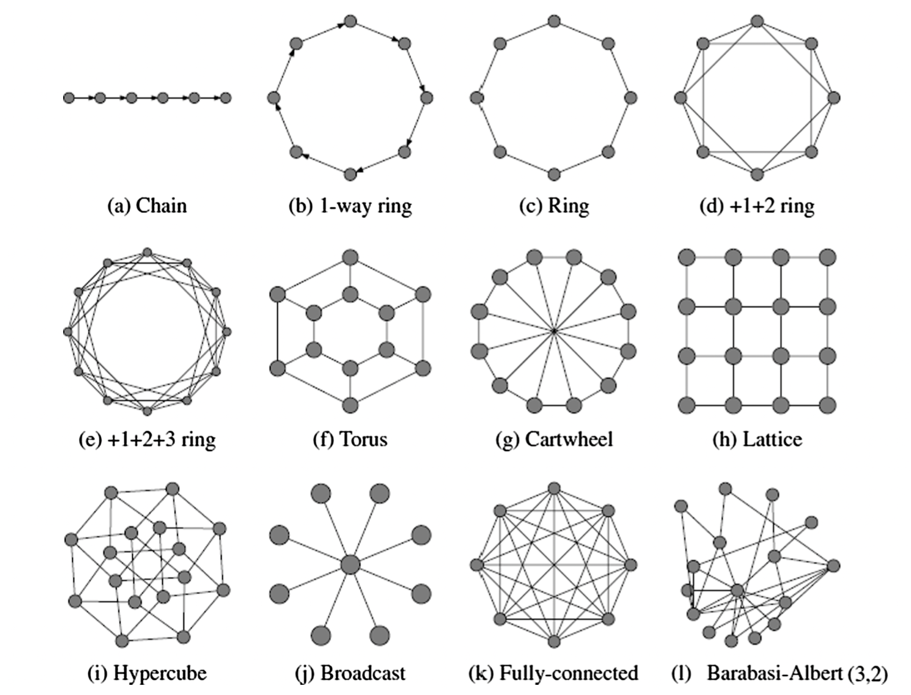
Island Models: Migration Topology
Notes:
Page fades in, red pops up. Only this page

Slide 9
Principles of optimizing GPU implementation
Exposing sufficient parallelism – reexamine granularity of parallelism
Optimizing memory access – aligned and coalesced memory access pattern
Optimizing instruction execution – organize threads in blocks and grids
Notes:
Page fades in, red pops up. Only this page

Slide 10
Granularity of parallel GAs on GPU
Granularity
Chromosome Level
(1C, 1 Thread)
Gene Level
(1C, Multiple Thread)
More Shared Memory - Disadvantageous
Advantageous, fully exploits computing power
Notes:
Page fades in, red pops up. Only this page

Slide 11
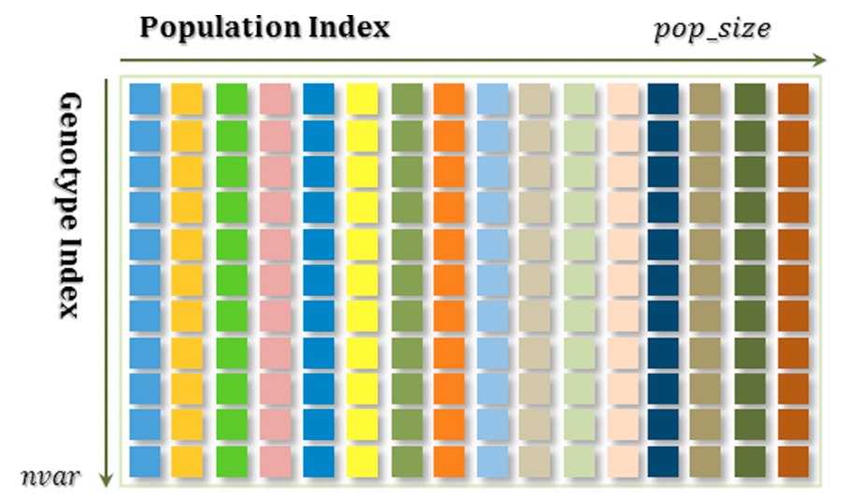
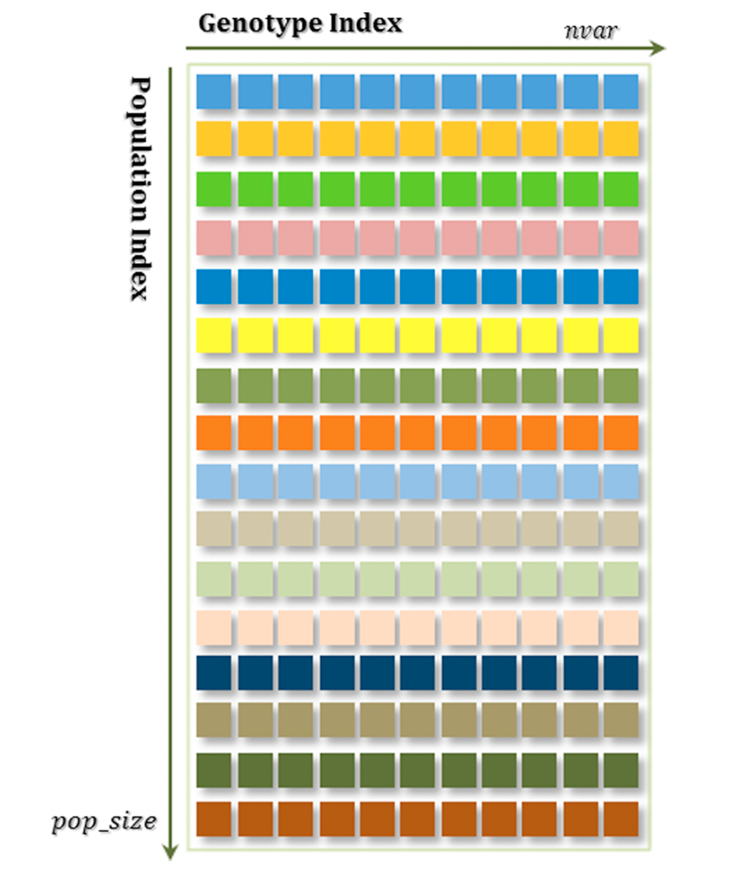
Data layout on global memory
Gene level granularity will take benefit of coalesced memory space
Gene Based Layout
Chromosome level granularity will take benefit of coalesced memory space
Chromosome Based Layout
Notes:
Page fades in, red pops up. Only this page

Slide 12
Review of parallel GAs on GPU: Master –Slave Model
Paper Name | Contribution
Zheng¹ et al. | CPU – Master, GPU – Slave, Only fitness calculation on GPU
Debattisti² et al. | Gene level granularity, two cut point crossover, 1 Thread Block – 2 individuals, each thread - 4 genes, same work done for mutation kernel and evaluation kernel
Oiso³ et al. | Unconstrained optimization, chromosome level granularity, one-cut point crossover, 1 Thread Block – 2 individuals, each thread - 1 genes, use of shared memory to reduce access to global memory, tournament selection for selection process
Notes:
Page fades in, red pops up. Only this page

Slide 13
Review of parallel GAs on GPU: Island Model
Paper Name | Contribution
Jaros⁴ | Knapsack problem, each GPU island, gene level granularity, tournament selection to pick and incorporate immigrants, unidirectional ring migration topology,
Notes:
Page fades in, red pops up. Only this page

Slide 14
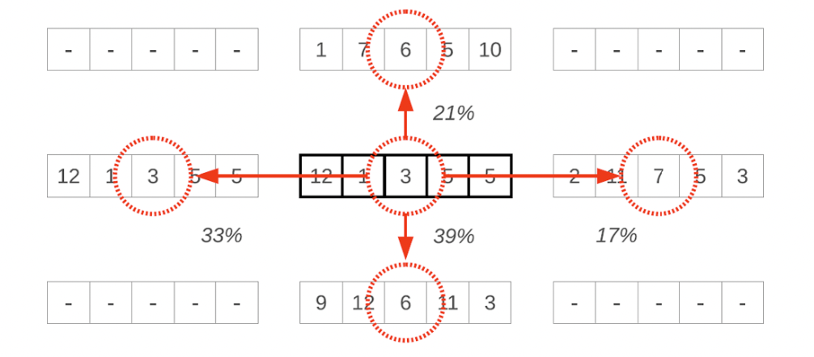
Review of parallel GAs on GPU: Cellular Model
Paper Name | Contribution
Cardenas⁵ et al. | Toroidal mesh structure, L5, C9, D17, C25 neighborhoods, gene level granularity, modified order crossover
Pinel⁶ et al. | Toroidal mesh structure, gene level granularity, one thread per gene, probabilistic replacement of gene for crossover
Zhao⁷ et al. | Toroidal, L5 neighborhood, two cut points crossover, gene level granularity, 1D grid, 1D block
Notes:
Page fades in, red pops up. Only this page

Slide 15
References
1 | Zheng, L., Lu, Y., Ding, M., Shen, Y., Guo, M., & Guo, S. (2011). Architecture-based performance evaluation of genetic algorithms on Multi/Many-core Systems. Proceedings of 14th IEEE international conference on computational science and en- gineering (pp. 321–334).
2 | Debattisti, S., Marlat, N., Mussi, L., & Cagnoni, S. (2009). Implementation of a simple genetic algorithm within the cuda architecture. In The Genetic and Evolutionary Computation Conference.
3 | Oiso, M., Matsumura, Y., Yasuda, T., & Ohkura, K. (2011). Implementation genetic al- gorithms to CUDA environment using data parallelization. The Journal Tehnički vjesnik, 18(4), 511–517.
4 | Jaros, J. (2012, June). Multi-GPU island-based genetic algorithm for solving the knapsack problem. In 2012 IEEE Congress on Evolutionary Computation (pp. 1-8). IEEE.
5 | Cárdenas,G.E.R.,Poveda,Ch,& Garcıá,O.H.(2017). A solution for the quadratic assignment problem (QAP) through a parallel genetic algorithm based grid on GPU. Applied Mathematical Sciences, 11(57), 2843–2854.
6 | Pinel, F., Dorronsoro, B., & Bouvry, P. (2012). Solving very large instances of the sche- duling of independent tasks problem on the GPU. Journal of Parallel and Distributed Computing, 16, 1–3.
7 | Zhao, Y., Chen, L., Xie, G., Zhao, J., & Ding, J. (2018). GPU implementation of a cellular genetic algorithm for scheduling dependent tasks of physical system simulation programs. Journal of Combinatorial Optimization, 35(1), 293–317.
Notes:
Page fades in, red pops up. Only this page

Slide 16
Thank You
Notes:
New names

